Slide 1


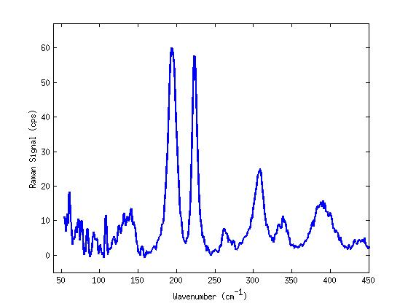
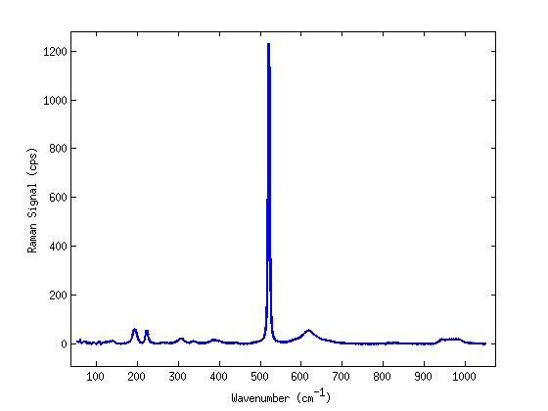
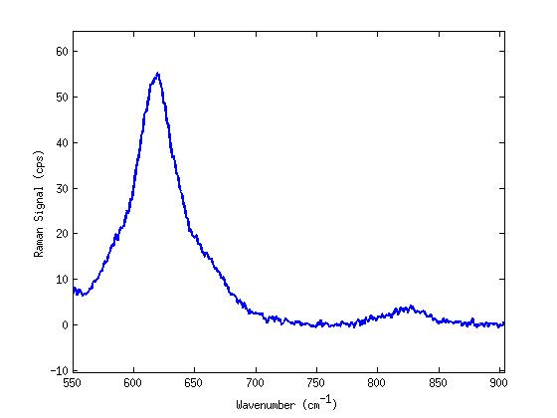
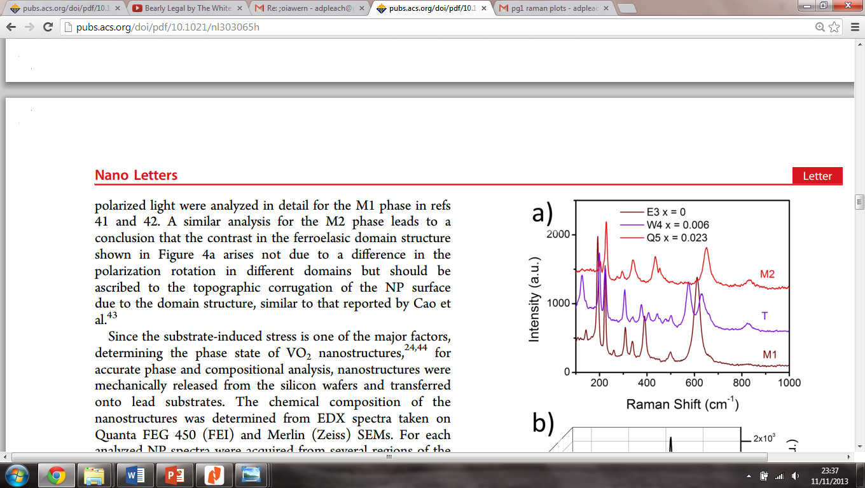
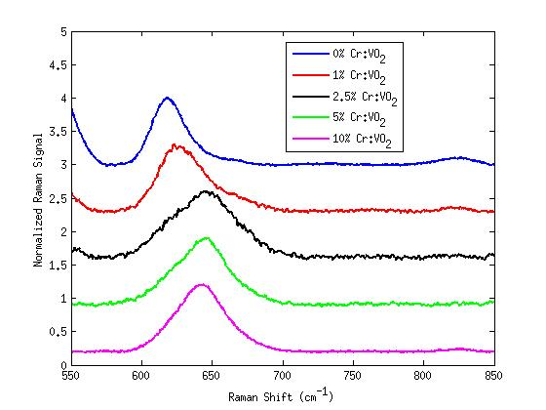
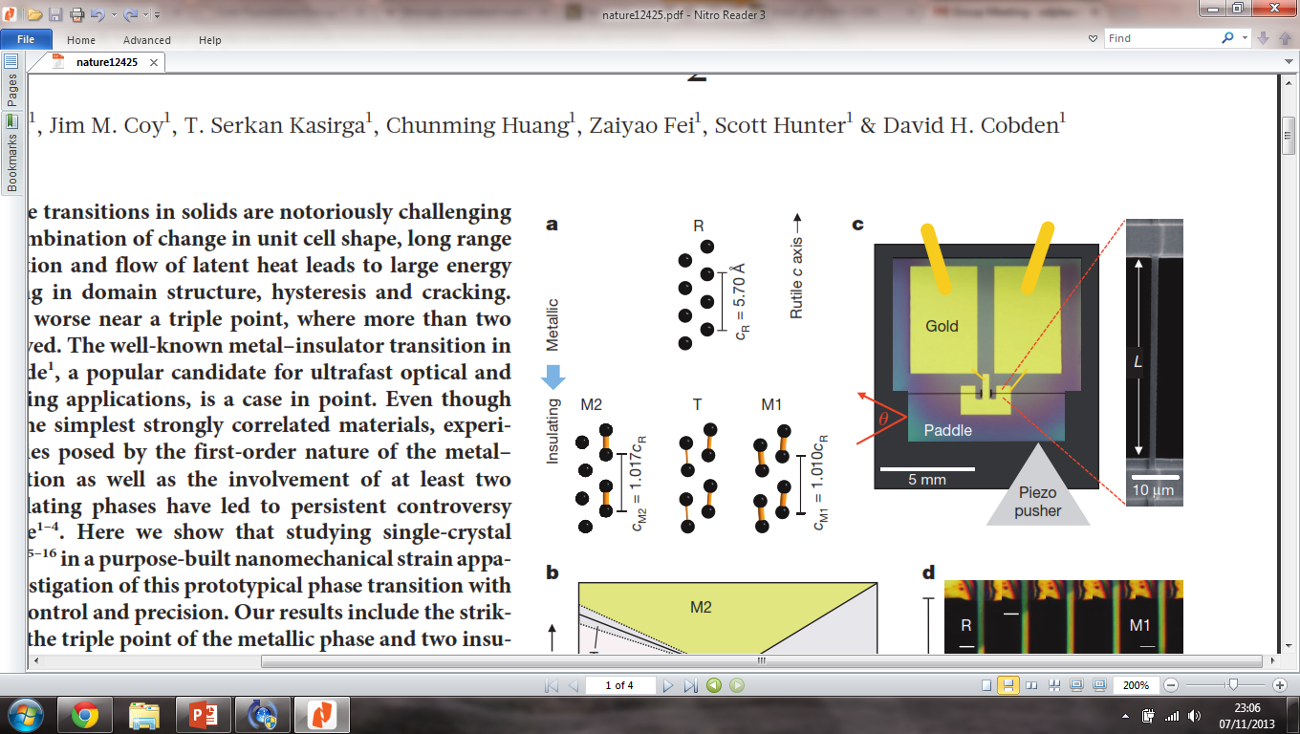
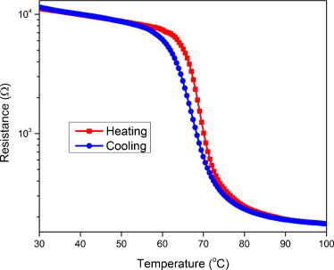
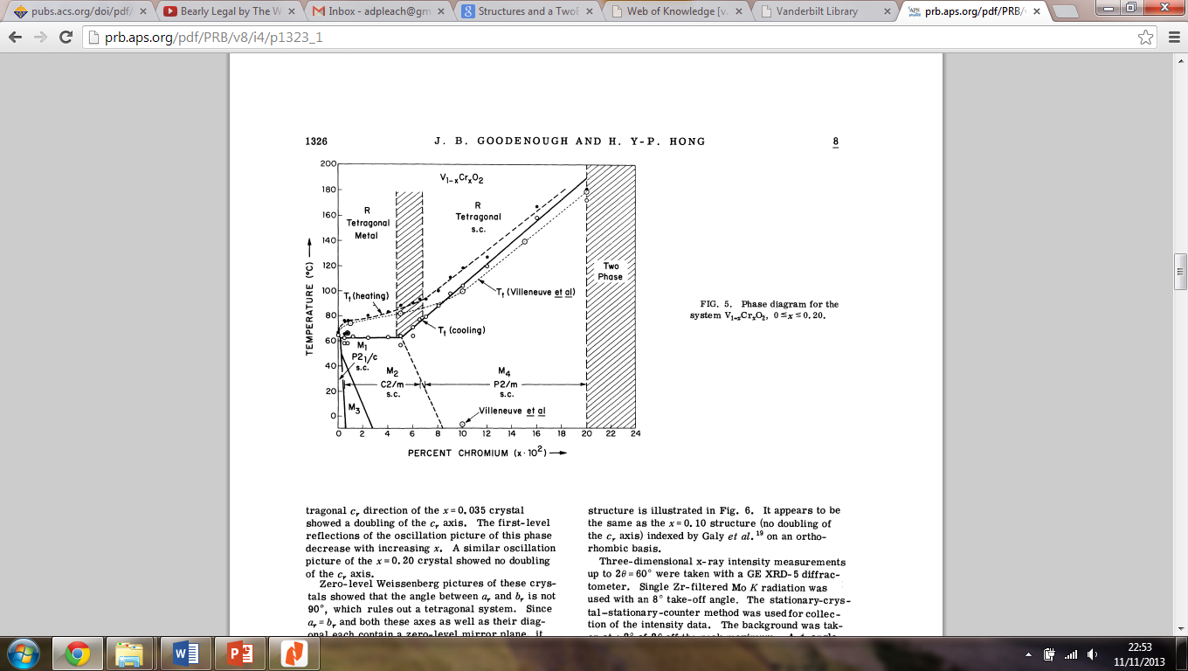
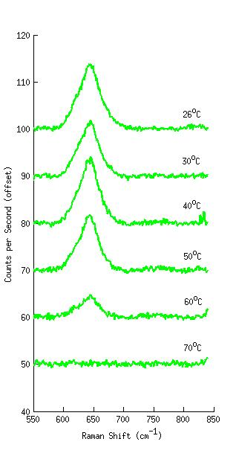
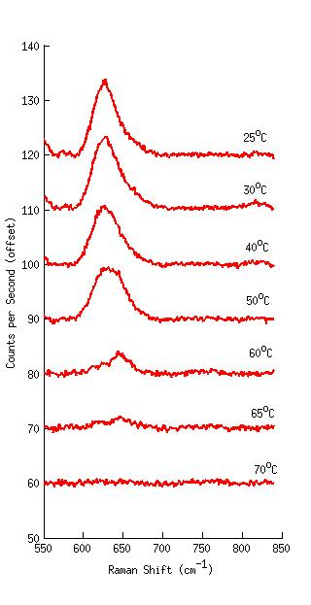
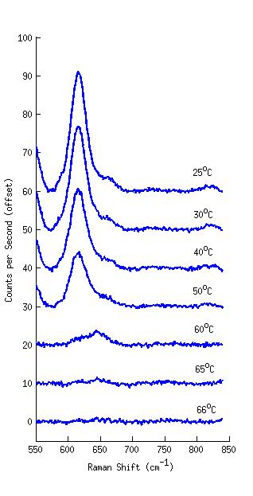
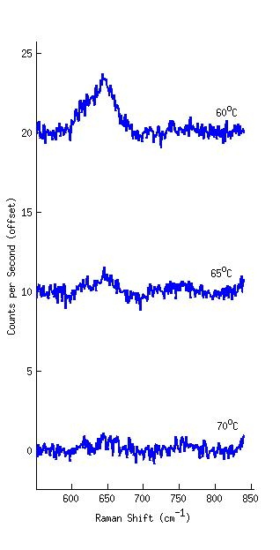
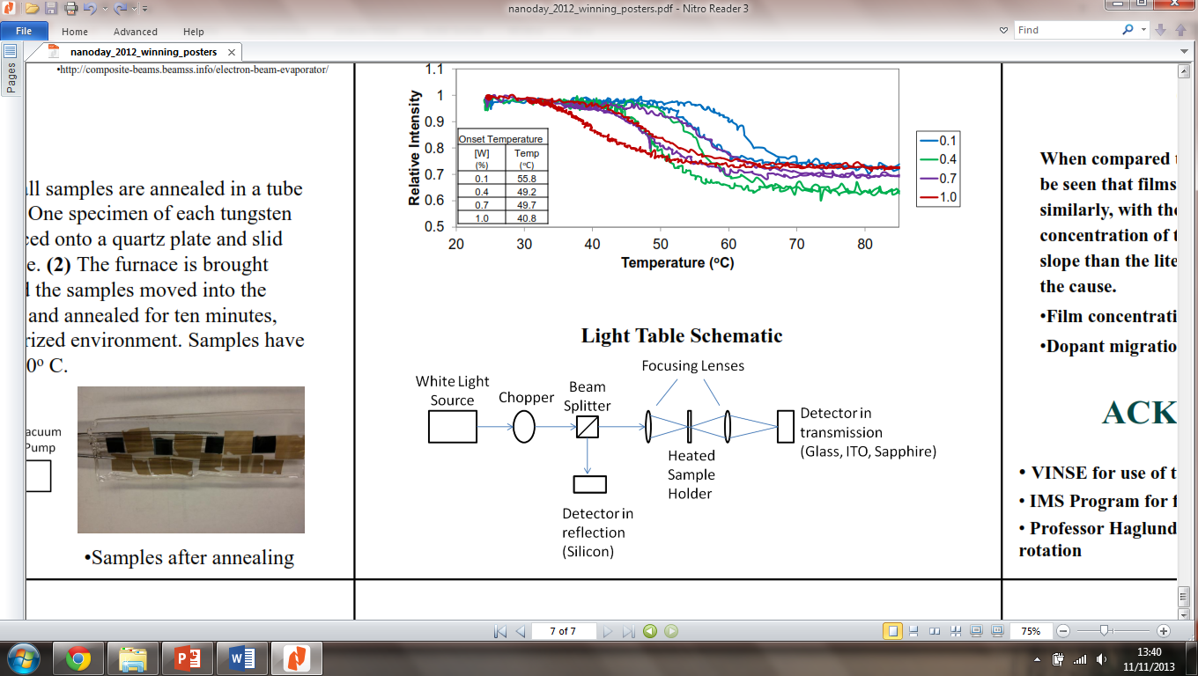
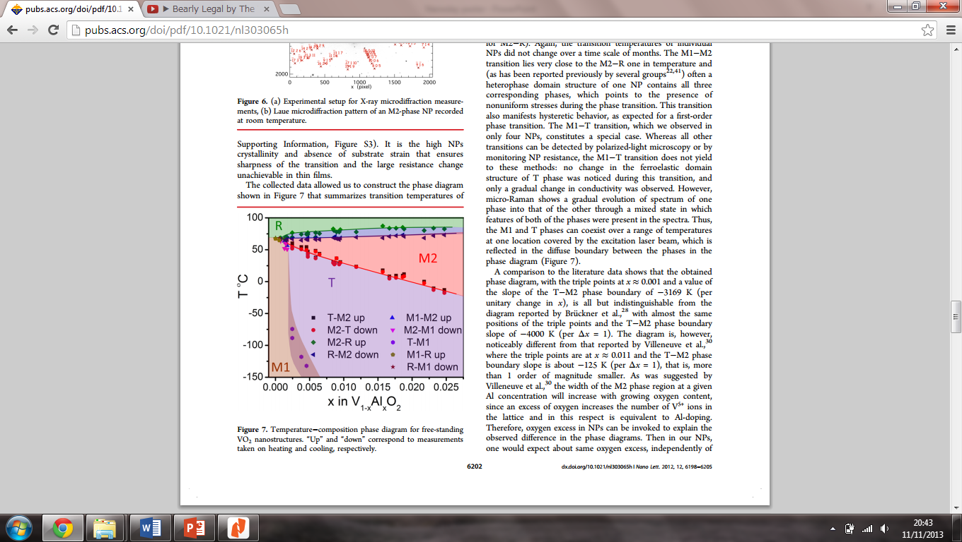
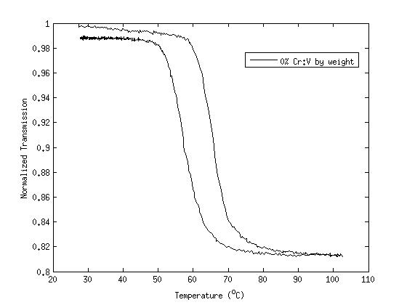
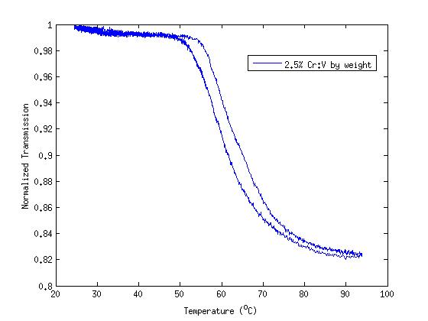
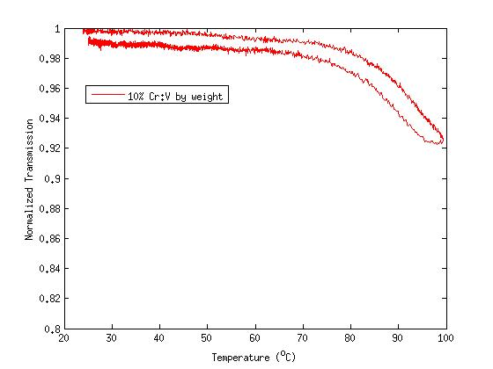
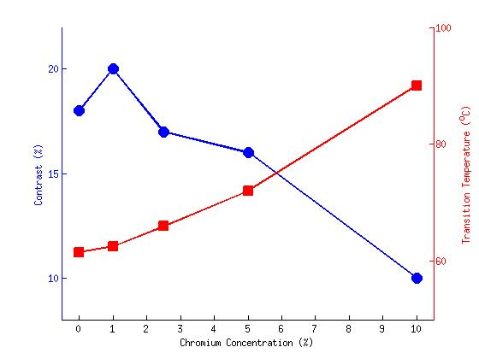
Periodic Metasurface Inverse Design via Deep Learning
Shengnan Han, You Zhou, Jason Valentine
¹Dept. of Mecanical Engineering, Vanderbilt University, Nashville, TN
Motivation:
Metasurface is a
Sample Preparation - Electron Beam Deposition:
Raman Microscopy:
Substrates cut, cleaned, and fixed to rotating disc in deposition chamber, along with crucible containing stoichiometric mix of vanadium oxide and chromium oxide powders
Chamber evacuated to pressure of 10⁻⁶ Torr
Once at pressure, crucible is bombarded with 8 kV electron beam, causing powder to be deposited on substrate
After deposition all samples annealed under flowing O₂
a)
b)
c)
Vanadium dioxide (VO₂):
Strongly correlated materials are a class of materials that show unusual magnetic or electronic properties
VO₂ is an example of such a material as it shows a rapid metal-insulator transition (MIT) over a narrow temperature range
This transition can be excited thermally and optically
Studying the phase transition in VO₂ is particularly interesting due to both its range of applications and its properties as a strongly correlated material
Structural transition
in VO₂ :
Full Raman spectrum b) shows large substrate peak at 520cm⁻¹
Spectra a) and c) are taken around this peak so VO₂ peaks resolved
Spectra from literature d) indicate that peaks in 600-900cm⁻¹ region of spectrum shift most noticeably on phase transition
Experimental data e) indicate that samples with ≥2.5% dopant concentration lie in the M2 phase
1% sample has midpoint shift value, but does not match T spectrum in lower wavenumber region, therefore, mixture of M1 and M2 phases is proposed
Schematic diagram of Electron Beam Deposition system^{[4]}
d)^{[3]}
e)
Advantages of Electron Beam Deposition as compared to Pulsed Laser Deposition:
Precursor Cost
Versatility
Simplicity
Shorter deposition time
Electronic transition
in VO₂ :
Optical Microscopy:
% Cr doping (by precursor weight)
Temperature dependent Raman (below):
As expected, the 5% sample (green) in M2 phase showed no shift of peak with temperature increased
1% sample (red) showed M2 peak at 60°C
- due to M1 to M2 transition?
- due to presence of M2 in sample?
Pure VO2 sample (blue) also indicated presence of M2 disagreeing with literature (left) for single crystal
Supports hypothesis of M1/M2 phase continuum
0 % (Pure VO₂)
1 %
2.5 %
5 %
10 %
100x
100x
100x
100x
100x
Arrangement of vanadium ions in the phases involved in the MIT, indicating their different vanadium chain periods and dimerization (yellow)^{[1]}
Resistance as a function of temperature of the VO₂ thin film deposited on (100) silicon^{[2]}
Samples change in color from deep purple to lighter blue
≥ 2.5% doped samples show blue “egg-shell” pattern inside each of these is a white “snowflake” feature
As doping concentration increases blue dots appear in film
Grainy texture in pure VO₂ is replaced by smoother features
Phase diagram for the single crystal system V_{(1-x)}Cr_{x}O₂ 0 ≤ x ≤0.2^{[5]}
Doping of VO₂:
It has been shown that doping VO₂ can alter its physical properties:
Chromium (Cr)
- affects magnetic susceptibility and transition temperature
Tungsten (W)
- transition temperature decreases, as % W increases
Aluminum (Al)
- transition temperature increases, as % Al increases
Magnesium (Mg)
- affects amount of visible light transmitted through the film
5% Cr
(by weight)
1% Cr
(by weight)
0% Cr
(by weight)
Transmission Measurements:
White light transmission measurements are performed to probe the optical transition of samples
Hysteresis measurements are taken from 25 to 100°C
Thin films & nanostructures:
Schematic diagram of the light table for transmission measurements
Summary & Next Steps:
Figures a) – c) show hysteresis curves for Cr by weight: 0%, 2.5% and 10% respectively
Figure d) shows a double y plot of hysteresis contrast (blue) and transition temperature (red) against Cr concentration
Shows strong trend of increasing transition temperature with increasing Cr concentration
Also shows a general decrease in quality of VO₂ film with Cr concentration as indicated by the decrease in contrast
Hypothesis: Cr-doped thin films show a continuum of M1/M2 phase with no T phase Low proportion of M1 at low dopant concentration and vice versa
M1 has a lower transition temperature ( ̴60°C) than M2 (70-80°C)
Above 2.5% Cr (by precursor weight) the quality of the VO₂ films is reduced
Not certain if M1 to M2 transition is seen or separate M1 to R and M2 to R transitions
X-Ray Diffraction study to probe structure of film further
RBS / Auger spectroscopy to determine exact film composition
Similar study with Al₂O₃ as dopant
Extensive previous work considering dopants has been performed on single crystal VO₂
There are challenges with single crystals in both fabrication and applications:
High cost
High temperature
Incompatible with devices
These challenges can be overcome using thin films
Thin film doping has been studied for a number of dopants (eg. Al^{[3]}), but Cr has not yet been explored
a)
b)
c)
d)
References & Acknowledgements:
[1] Park, J.H.; Coy, J.M. et al. Nature 2013 500
[2] Merced, E.; Tan, X. & Sepúlveda, N. Sensor Actuat A-Phys 2013 196
[3] Strelcov, E.; Tselev, A. et al. Nano Lett. 2012 12
[4] http://thinfilm.snu.ac.kr/bbs/view.php?id=research&no=21
[5] Goodenough, J.B.; & Hong, H.Y-P. Phys. Rev. B 1973 8, 4
This project was supported by both the IMS Program at Vanderbilt University and the Air Force Office of Scientific Research under Grant FA9550-10-1-0366
Portions of this work were performed at the Vanderbilt Institute of Nanoscale Science and Engineering, using facilities renovated under NSF (ARI-R2 DMR-0963361) and NSF EPS-1004083.
Temperature−composition phase diagram for Al doped VO₂ nanostructures created using thin film deposition methods. “Up” and “down” correspond to measurements taken on heating and cooling, respectively^{[3]}

Slide 2
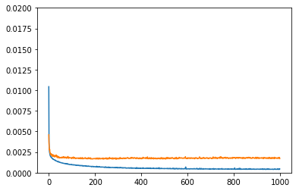
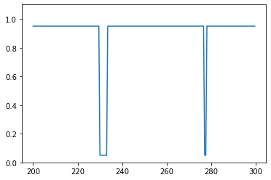
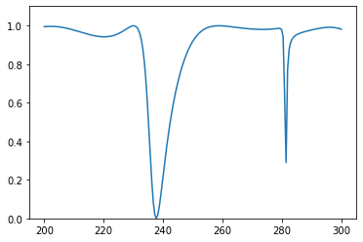
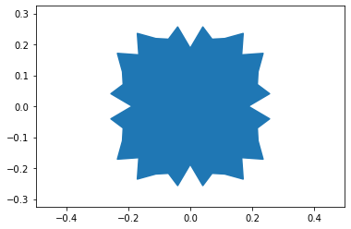
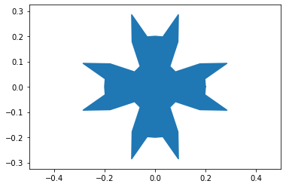
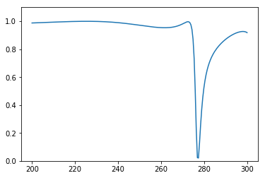
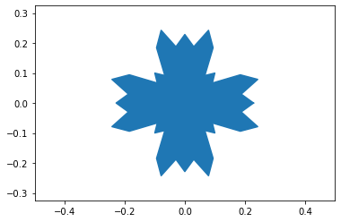

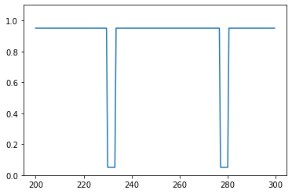
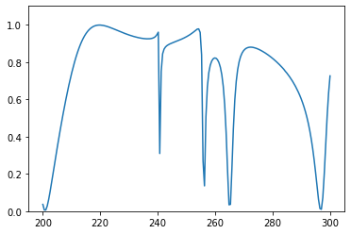
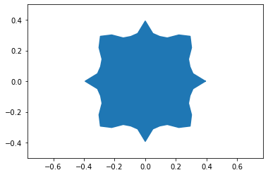
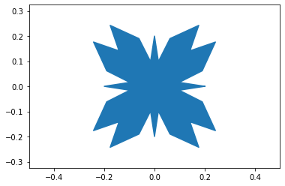
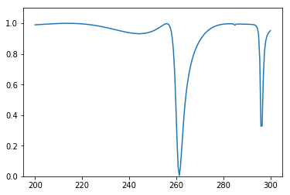
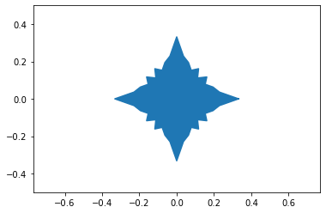
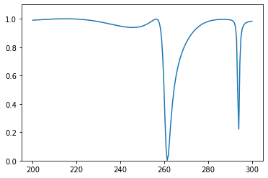
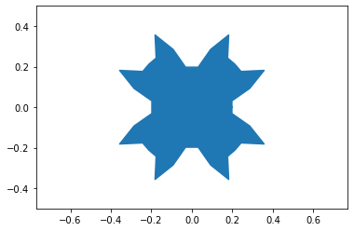
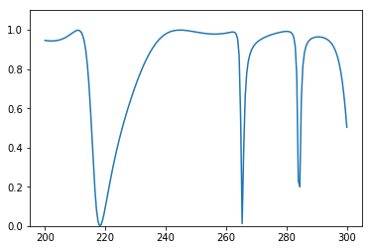

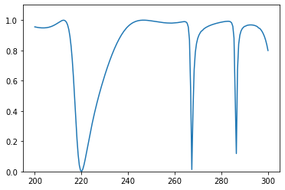
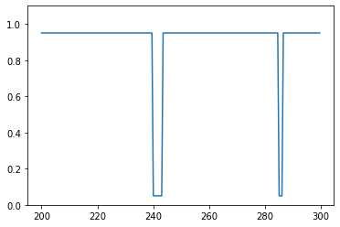
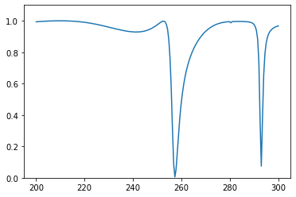
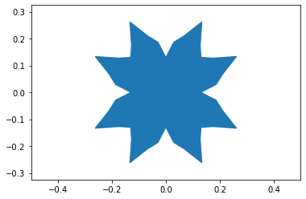
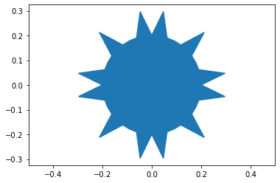
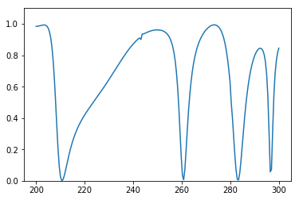
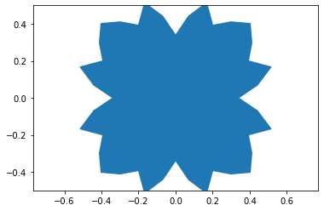
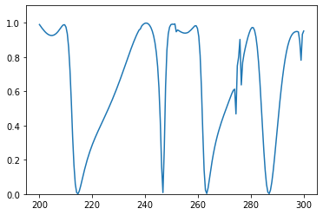
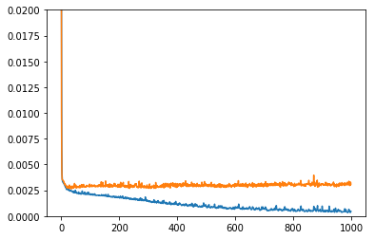
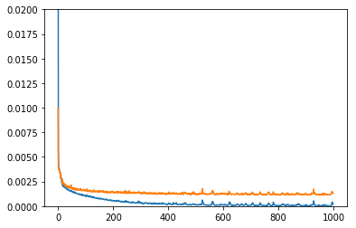
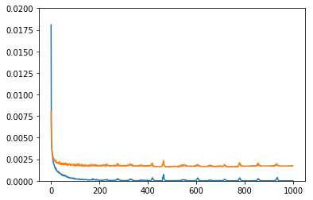
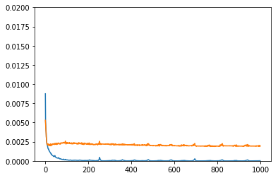
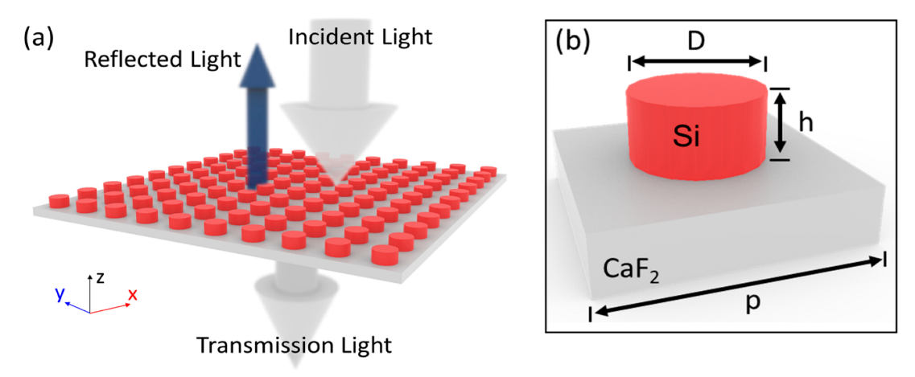
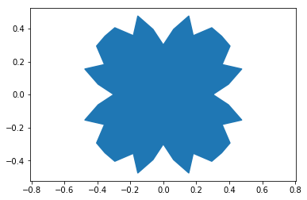
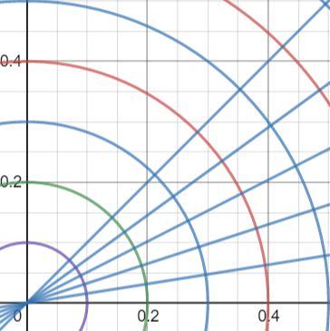
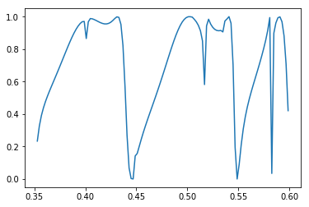























Background:
Metasurface is composed of metamaterial that human controls its optic property.
Inverse design is to design material based on functionality we need.
Spectrum is the key to metasurface inverse design because it describe metasurface optic property.
Training neural network with whole data set:
Deep forward neural network(DFNN) is set to have 8 layers with each layers having 200-80-80-100-80-40-30-20-6 units and dropout layer which probability sets to 0.5. The spectrum S = [S1, S2, …, S200] is taken as the input of the DFNN. A design (1, 600) is calculated as outputs. The training is done by minimizing the cost function.
User Application:
User can specify position and width of peaks.
Experiment shows that quality of predicted depends on if the input spectrum has been trained by neural network.
Following graphs show that if the width of the spectrum is unprecedented the prediction can be poor
Predicted design
Loss vs echo Training with whole data set
Desired spectrum
Spectrum generated by predicted design
True Shape
True Spectrum
Predicted Shape
Predicted Spectrum
Motivation:
Inverse design process of metamaterial is time consuming by traditional parameter sweeping method. This project aims to boost inverse design process via deep learning.
Following graphs show that if the distribution of peaks is precedented, prediction can be poor
Goal:
Use deep neural network to learn from dataset where spectrums are predictor and designs of periodic metasurface are the regression target. The task is to predict design for the given spectrum. The performance is measured by mean square error of predicted shapes and comparing spectrum of predicted shape.
Desired spectrum
Spectrum generated by predicted design
Predicted design
Dataset:
Predictor is the transmission spectrum and regression target is the design of metasurface.
Periodic metasurface is composed of uniform unit cells. Our design of unit cell fixes the height on z-axis and explores shapes on xy-axis.
4-fold symmetry is applied to design to ensure lights propagating through the x-axis and y-axis has the same interaction.
Design a polar-coordinate based depth search first algorithm that produces all possible 4-fold geometries.
Use Meep to generate spectrum. Spectrum is validated by CST and S4.
Total data size 4988. Predictor is a vector (4988, 200) and regression target is (4988, 6)
Training neural network with one peak, two peaks, three peaks and four peaks:
Deep forward neural network(DFNN) is set to have 8 layers with each layers having 200-80-80-100-80-40-30-20-6 units. The spectrum S = [S1, S2, …, S200] is taken as the input of the DFNN. A design is calculated as outputs. The training is done by minimizing the cost function.
Summary:
Neural network works well with periodic neural network inverse design
Polar coordinate based 4 fold geometry generating methods is capable of generating all possible 4-fold shapes.
Loss vs echo Training with 1 Peak
Loss vs echo Training with 2 Peaks
Loss vs echo Training with 3 Peaks
Loss vs echo Training with 4 Peaks
Shape in normalized unit
Transmission vs normalized frequency
True Shape
True Spectrum
Predicted Shape
Predicted Spectrum
Peaks Distribution in Data Set:
Future Work:
Explore cavity and height effect on spectrum to increase data set and hope that peaks can spread evenly across frequency.
Create a better user interface to produce a spectrum
1 Peak Distribution
2 Peaks Distribution
3 Peaks Distribution
4 Peaks Distribution

